Slide 1

An Enhanced Framework for Zero-Shot
Reinforcement Learning
Lauriane Teyssier
Advisor : Zhang Ya-Qin

Slide 2
Content
Zero-Shot RL Introduction
Related Works
Methodology
Experiments
Conclusion

Slide 3
Content
Zero-Shot RL Introduction
Related Works
Methodology
Experiments
Conclusion

Slide 4
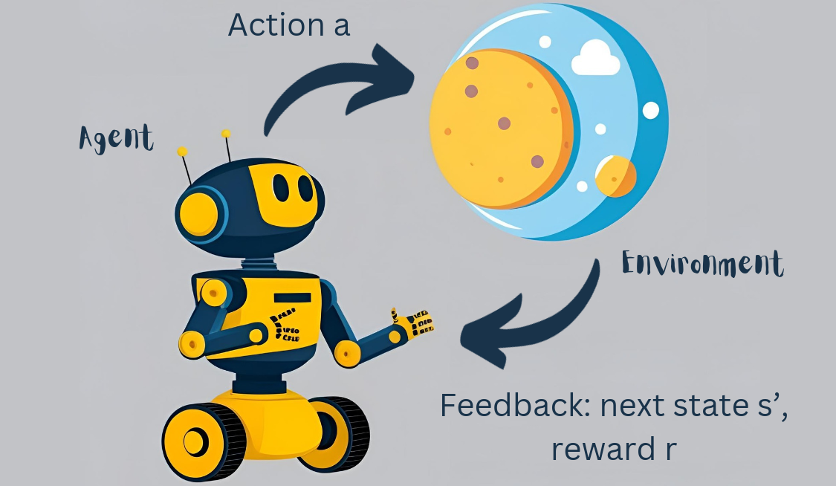

Introduction – Zero-Shot RL
Training Phase
Inference Phase
ACTION
ACTION
Traditional RL
REWARD
STATE
STATE
Notes:
Introduction
- what is zero shot RL
- why is it important and difficult
Data driven RL
save computing power

Slide 5

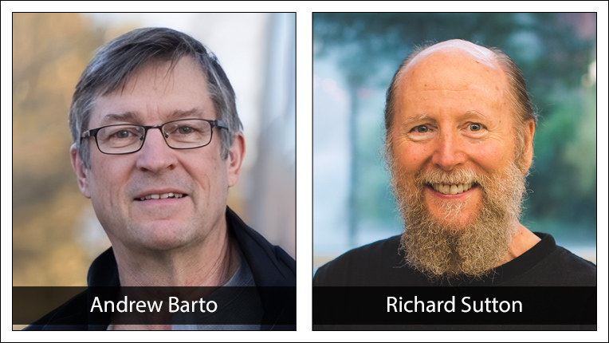
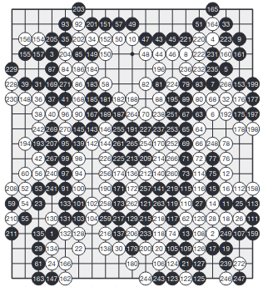
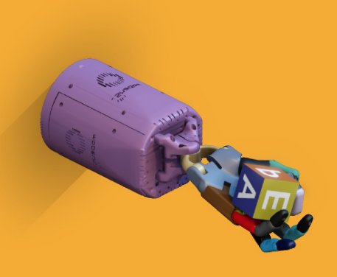
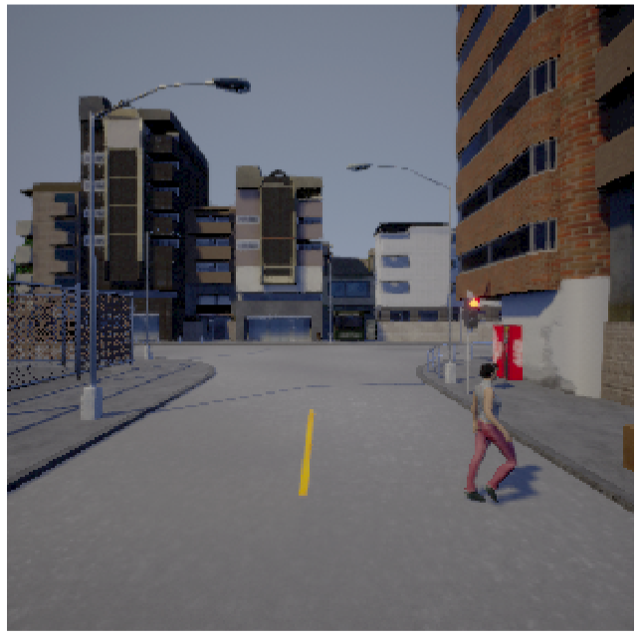

Introduction – RL
Autonomous Driving
Gaming
NLP
Robotic
Toromanoff et al. (2020) ‘End-to-End Model-Free Reinforcement Learning
for Urban Driving using Implicit Affordances’ in IEEE/CVF CVPR
Silver et al. (2016) ‘Mastering the game of Go with deep neural networks and tree search’ in Nature
DeepSeek-AI (2025) DeepSeek-R1: Incentivizing Reasoning Capability in LLMs via Reinforcement Learning in arXiv
OpenAI et al. (2018) ‘Learning Dexterous In-Hand Manipulation’ in CoRR
Handle multiple complex tasks (lane keeping, pedestrians and vehicles avoidance, traffic light detection)
AlphaGo wins against Fan Hui, european Go champion
RL for improving LLM reasoning capabilities
Train a robotic hand simluation to manipulate objects with human-like dexterity, transfer to a real robot hand
https://amturing.acm.org/
Notes:
Impact of Zero-Shot RL: why is it important / significance ?
- Able to handle complex tasks + tasks oustide the training distribution
RL is general is promising but can t adapt to diverse rewards settings
Still, methods rn have limited expressivity. training and learning not robust, performance is limited
-> zero shot RL
Robots = 100 of tasks, just one is not efficient + computational cost

Slide 6
Introduction – RL
Autonomous Driving
Gaming
NLP
Robotic
Toromanoff et al. (2020) ‘End-to-End Model-Free Reinforcement Learning
for Urban Driving using Implicit Affordances’ in IEEE/CVF CVPR
Silver et al. (2016) ‘Mastering the game of Go with deep neural networks and tree search’ in Nature
DeepSeek-AI (2025) DeepSeek-R1: Incentivizing Reasoning Capability in LLMs via Reinforcement Learning in arXiv
OpenAI et al. (2018) ‘Learning Dexterous In-Hand Manipulation’ in CoRR
Handle multiple complex tasks (lane keeping, pedestrians and vehicles avoidance, traffic light detection)
AlphaGo wins against Fan Hui, european champion
RL for improving LLM reasoning capabilities
Train a robotic hand simluation to manipulate objects with human-like dexterity, transfer to a real robot hand
High Computational Cost
Task Specific
Not Data Driven
https://amturing.acm.org/
Notes:
Impact of Zero-Shot RL: why is it important / significance ?
- Able to handle complex tasks + tasks oustide the training distribution
RL is general is promising but can t adapt to diverse rewards settings
Still, methods rn have limited expressivity. training and learning not robust, performance is limited
-> zero shot RL
Robots = 100 of tasks, just one is not efficient + computational cost
scaling abilities

Slide 7
Introduction – RL Generalization
Training
Inference
Reward
Traditional RL
on 1 task
direct
fixed beforehand
Multi-task RL
on multiple tasks
direct
fixed beforehand
Transfer Learning
on multiple tasks
fine-tuning
any in transfer space
Goal-Conditionned RL
on any transitions
direct
any state (goal)
Zero-Shot RL
on any transitions
direct
any
Notes:
There are some other alternatives (finetuning, multi task RL, trasnfer learning, ... but limited)

Slide 8
Introduction – Zero-Shot RL
Training Phase
Inference Phase
ACTION
ACTION
Traditional RL
REWARD
STATE
STATE
ACTION
ACTION
Zero-Shot RL
REWARD
STATE
STATE
Touati et al. (2023) ‘Does Zero-Shot Reinforcement Learning Exist?’ in ICLR
Notes:
Introduction
- what is zero shot RL
- why is it important and difficult
Data driven RL
save computing power

Slide 9
Introduction – Zero-Shot RL
Training phase
Inference phase
ACTION
ACTION
traditional RL
REWARD
A zero-shot RL agent is an agent that can solve any RL task in a given environment, instantly, after an initial reward-free learning phase.
STATE
STATE
ACTION
ACTION
zero-shot RL
REWARD
STATE
STATE
Touati et al. (2023) ‘Does Zero-Shot Reinforcement Learning Exist?’ in ICLR
Notes:
+ why it is a difficult challenge (current pb the related works are trying to tackle, but their limitation)

Slide 10
Content
Zero-Shot RL Introduction
Related Works
Methodology
Experiments
Conclusion

Slide 11
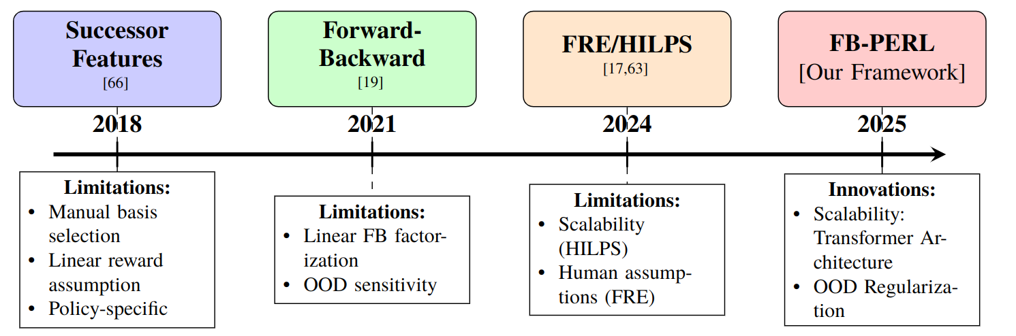
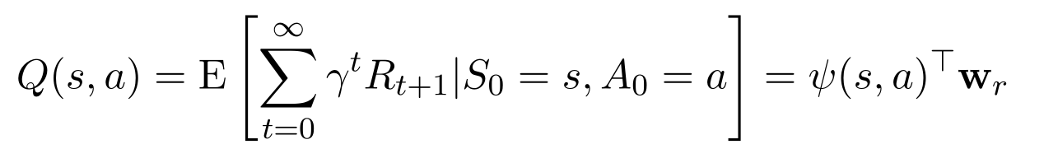
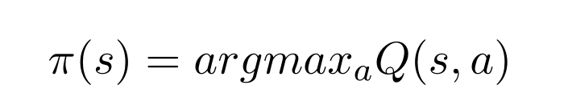
Introduction – Different Methods for Zero-Shot
Successor features
action retrieval:
Forward-Bakward Representations
1. Dayan (1993) ‘Improving Generalization for Temporal Difference Learning: The Successor Representation’ in Neural Computation
2. Touati et al. (2023) ‘Does zero-shot reinforcement learning exist?’ in ICLR 2023
Notes:
Different methods
Important : very active research field, and recent developments
Advantage:
- explicability
- transfer learning to all linear r rewards

Slide 12
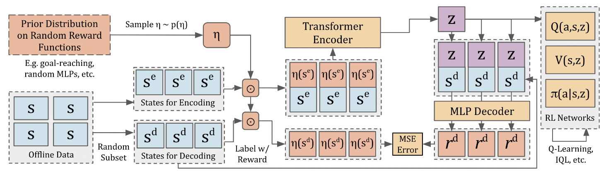
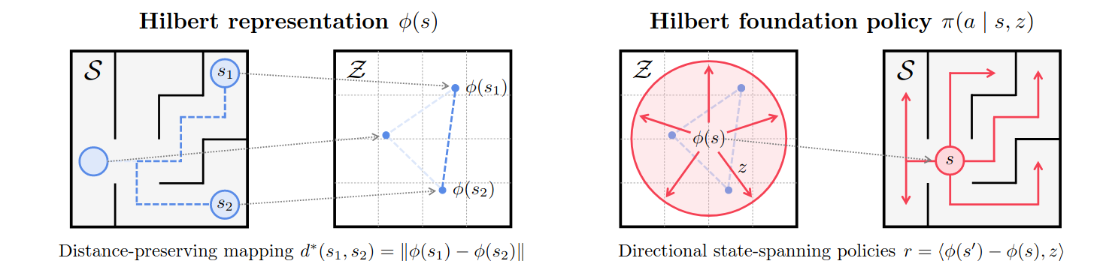
Introduction – Different Methods for Zero-Shot RL
FRE
Frans et al. (2024) ‘Unsupervised Zero-Shot Reinforcement Learning via Functional Reward Encodings’ in arXiv
HILPS
Park et al. (2024) ‘Foundation Policies with Hilbert Representations’ in arXiv
Notes:
FRE:
Idea: learn a latent representation that can represent any arbitrary reward functions based on their samples of state-reward pairs
+ : no linear reward
- : needs human prior on prior distribution over reward functions (we show that a mixture of random unsupervised reward functions, such as goal-reaching and random MLP rewards, are a reasonable choice for the reward prior)

Slide 13
Introduction – Different Methods for Zero-Shot
SF
FB
FRE
HILPS
Notes:
Back to the list of problems to fix:
- OOD sensitivity
- expressivity
- linear basis selection & human assumptions

Slide 14
Introduction – Behavioral Foundation Model
Behavioral Foundation Model
Traditional RL
Zero-Shot RL
Imitation Learning
Forward-Backward Representations
Reward
Policy
1. Pirotta et al. (2024) ‘Fast Imitation via Behavior Foundation Models’ in arXiv
Demo Data
Actor
Forward-Backward Representations
Policy
Critic
2. Tirinzoni et al. (2024) ‘Zero-Shot RL from Zero-Shot Whole-Body Humanoid Control via Behavioral Foundation Models’ in NeurIPS
Notes:
BFM = RL fundation model
Tirinzoni, A. et al. (12.2024)
‘Zero-Shot Whole-Body Humanoid Control via Behavioral Foundation Models’: metamotivo pipeline, use GAN type architecture for policy regularization
GAN structure that determines FB results from the simulation results, and add this loss to FB loss for better training

Slide 15
Content
Zero-Shot RL Introduction
FB Representations
Related Works
Neural Network Architecture
Methodology
Experiments
Regularization
Conclusion

Slide 16
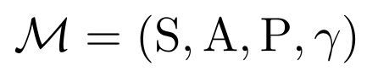
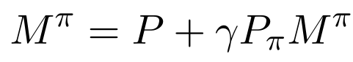
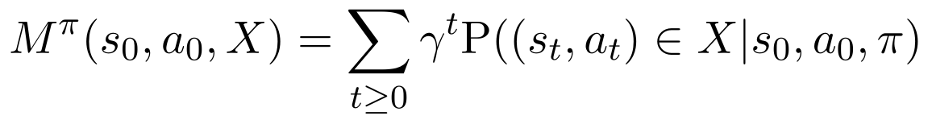
Introduction - Zero-Shot RL with FB Representations
Reward free MDP​
Bellman update
Loss
Successor measure
Forward Backward representation (low rank decomposition)
Policy retrieval
Touati et al (2023) Does zero-shot reinforcement learning exist? in ICLR 2023
Notes:
M = discounted sum of future occurrences of each state
Pb: scalability & expersivity (linear)
-> want to improve from there
Rho = distribution of fixed dataset
Rely on values that potentially do not exist within the dataset
TODO
Pb: FB big matrices lack expressivity + offline RL that suffers distributional shift as limitation

Slide 17
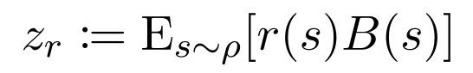
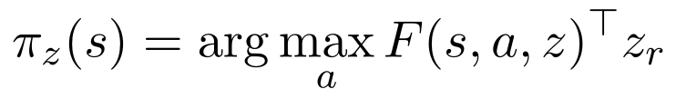
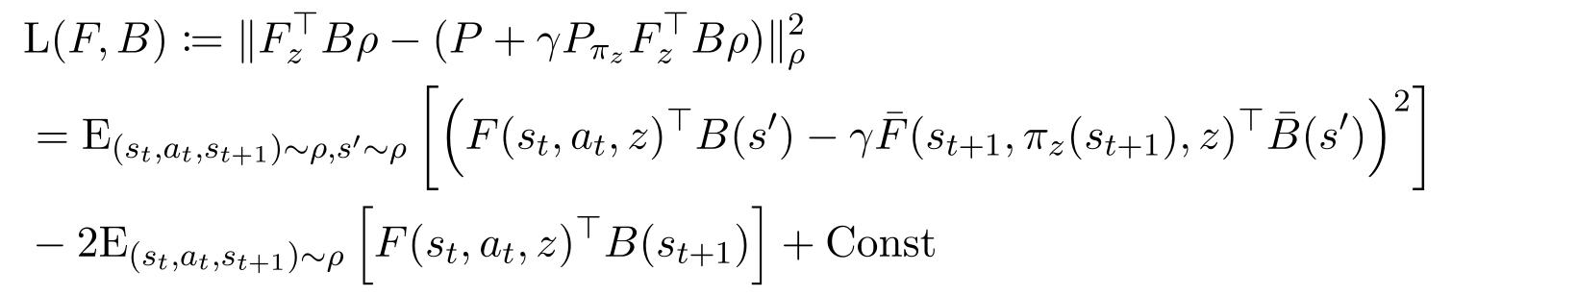
Introduction - Zero-Shot RL with FB Representations
Reward free MDP​
Bellman update
Loss
Successor measure
Forward Backward representation (low rank decomposition)
Policy retrieval
This thesis aims to propose an Enhanced FB-based Algorithm
Limitation
Out Of Distribution
Distributional Shift Errors
Fixed Dataset
Matrix Representation
-> Limits FB Expressivity
Touati et al (2023) Does zero-shot reinforcement learning exist? in ICLR 2023
Notes:
M = discounted sum of future occurrences of each state
Pb: scalability & expersivity (linear)
-> want to improve from there
Rho = distribution of fixed dataset
Rely on values that potentially do not exist within the dataset
TODO
Pb: FB big matrices lack expressivity + offline RL that suffers distributional shift as limitation

Slide 18
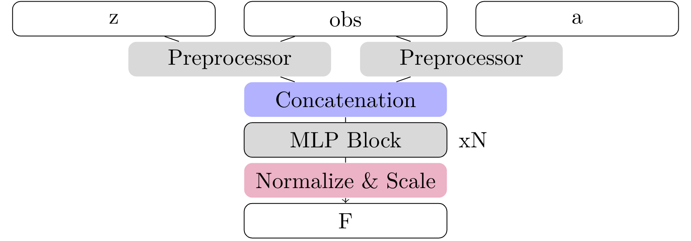
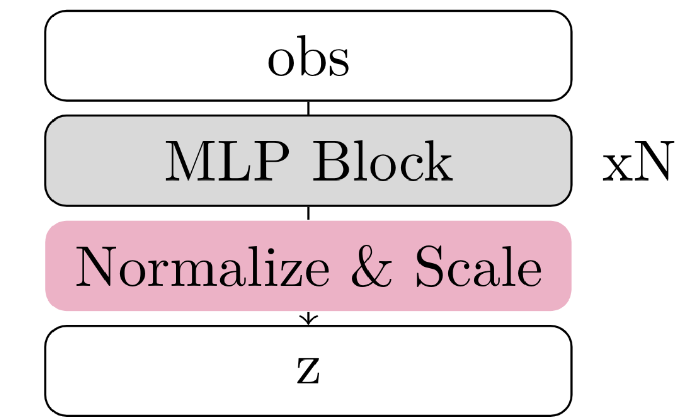
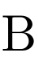
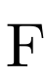
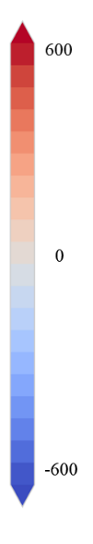
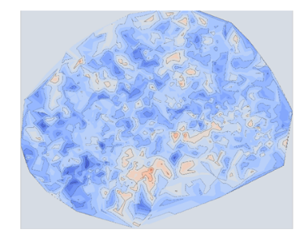
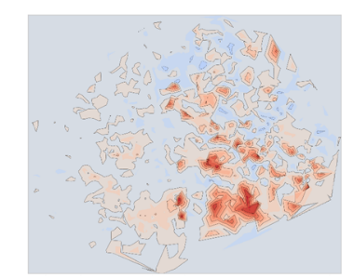
Neural Network Enhancement
Scalability
Theoritical Compliance
Performance
Distribution of the Successor Measures in the Projected State-Action Space
Notes:
First objective: Render the original MLP scalable (residual connections, dropout, normalization, ...)
Bad because performance but also inconsistent M with the theoritical fundation + no scalability/adaptability (new figures for MLP problem evidence)
But not better than the original...
So first handmade use of attention -> improvements
Why Transformers make sense:
- good for temporal relationships (B) - as per LLM
- good for F for interactions between the differents inputs
optimization of different HP (number of heads, dropout for F only, ...)

Slide 19
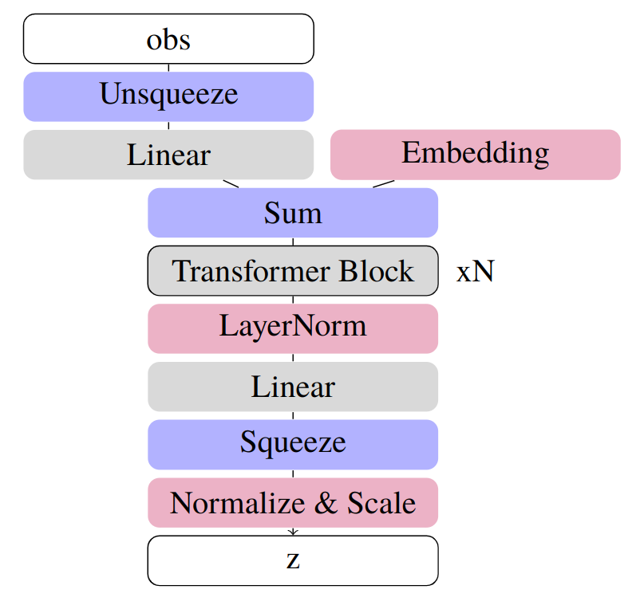
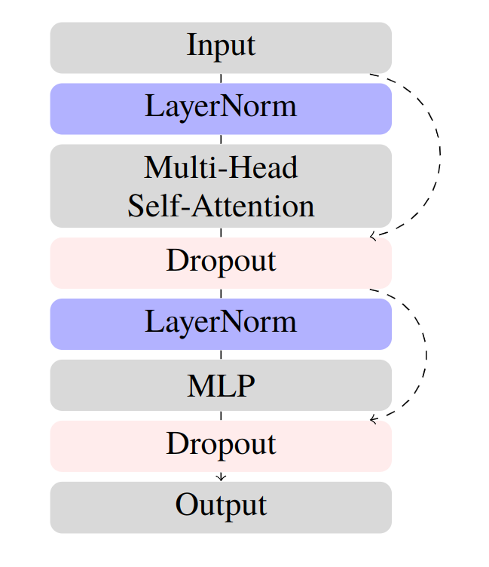
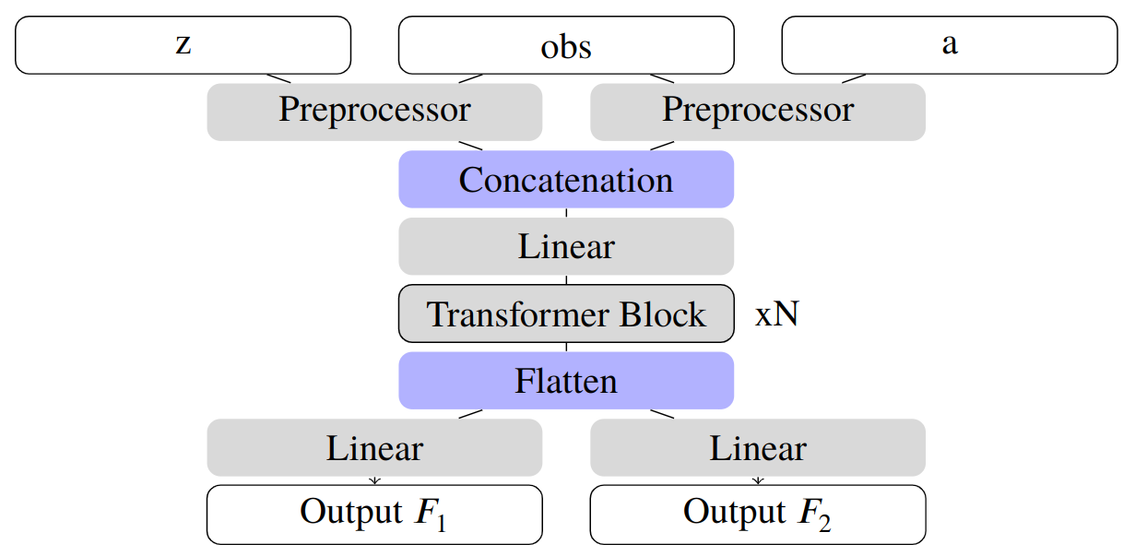
NN: Enhance FB Expressivity
Scalability
Theoritical Compliance
Performance
Notes:
First objective: Render the original MLP scalable (residual connections, dropout, normalization, ...)
Bad because performance but also inconsistent M with the theoritical fundation + no scalability/adaptability (new figures for MLP problem evidence)
But not better than the original...
So first handmade use of attention -> improvements
Why Transformers make sense:
- good for temporal relationships (B) - as per LLM
- good for F for interactions between the differents inputs
optimization of different HP (number of heads, dropout for F only, ...)

Slide 20
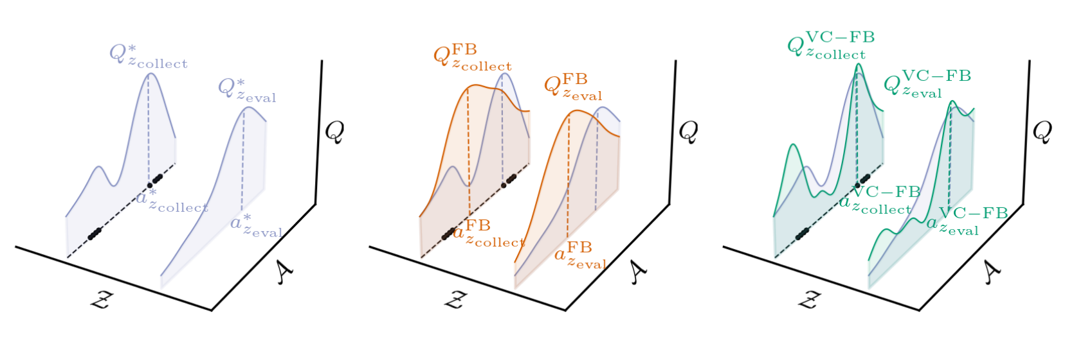
Regularization: Fight Distributional Shift
Out Of Distribution Errors
Fixed Dataset
Jeen et al. (2024) ‘Zero-shot reinforcement learning from low quality data’ in NeurIPS
Notes:
use figure + equation
present the limits of CQL
So rather better alternative : in-sample learning

Slide 21
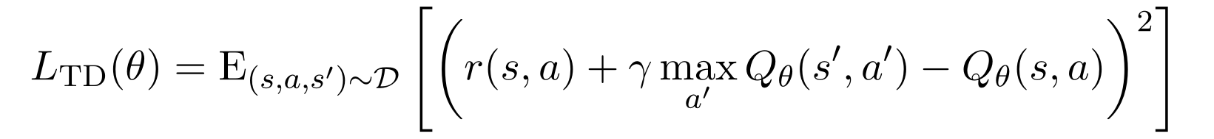
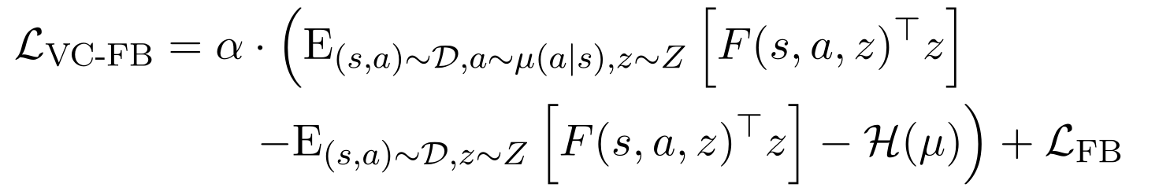
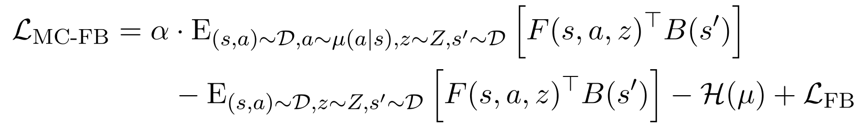
Regularization: Fight Distributional Shift
Out Of Distribution Errors
Fixed Dataset
Current state-of-the-art
Better alternative
-> adapt Conservative Q-learning
MCFB/VCFB
Implicit Q-learning
Jeen et al. (2024) ‘Zero-shot reinforcement learning from low quality data’ in NeurIPS
Kostrikov et al. (2022) ‘Offline reinforcement learning with implicit Q-learning’ in ICLR
Notes:
use figure + equation
present the limits of CQL
So rather better alternative : in-sample learning

Slide 22
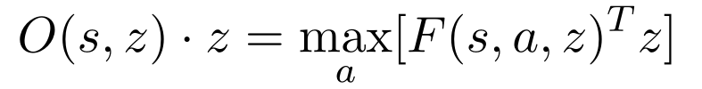
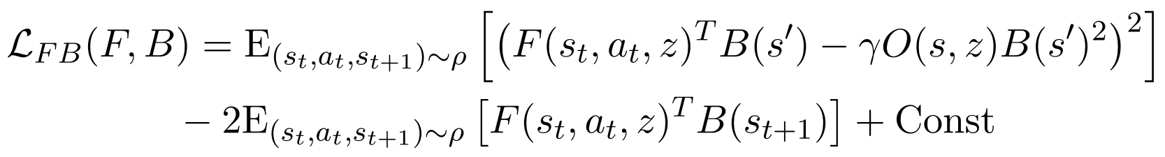
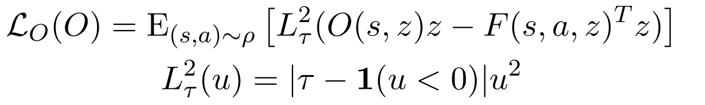
Regularization: Fight Distributional Shift
Algorithm
Out Of Distribution Errors
Original FB Loss
Substitute the Problematic Term with a New Learnable Variable
Updated FB Loss
Learn the New Variable Using Expectile Regression

Slide 23
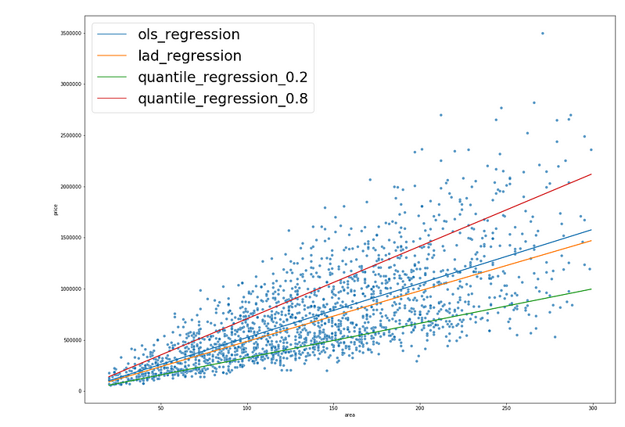
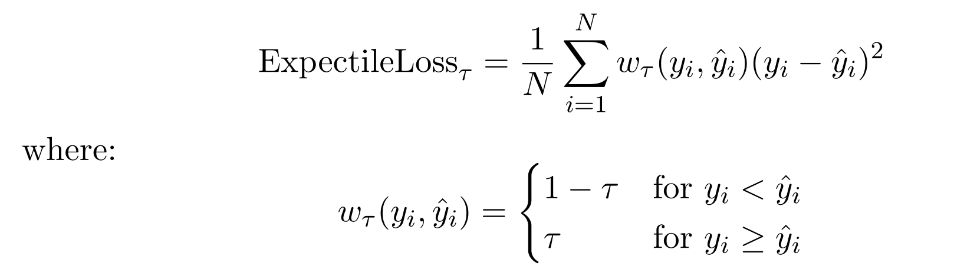
Regularization: Fight Distributional Shift
Expectile regression
Substitute the Problematic Term with a New Learnable Variable
Updated FB Loss
Learn the New Variable Using Expectile Regression
Notes:
Idea of expectile loss: get rid of OOD
Pb: if tau too high, then emplifies the pb...

Slide 24
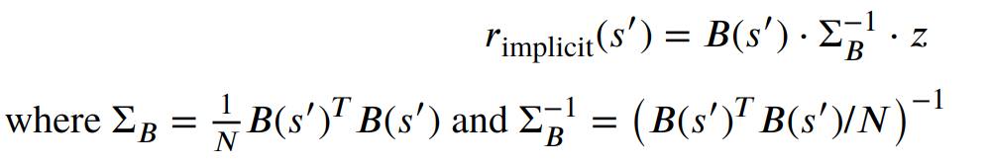
Regularization: Fight Distributional Shift
Substitute the Problematic Term with a New Learnable Variable
Updated FB Loss
Learn the New Variable Using Expectile Regression
optimized
Q-learning ?
Additional F/B Regularization
Notes:
In addition to this theoritical work, some work on computation efficiency has been done (thinking about switching to JAX, compiling the model, quantization, ... and code optimization)

Slide 25
Content
Zero-Shot RL Introduction
Related Works
Methodology
Experiments
Conclusion

Slide 26
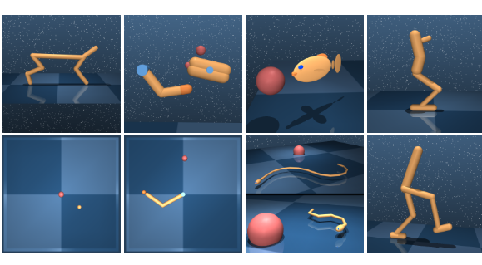
Experiments: The Dataset
Benchmarking Domains. Top: Cheetah, Finger, Fish, Hopper. Bottom: Point-mass, Reacher, Swimmer (6 and 15 links), Walker.
Tassa et al. (2018) ‘DeepMind control suite’ in arXiv

Slide 27
Experiments: The Dataset
Benchmarking Domains. Top: Cheetah, Finger, Fish, Hopper. Bottom: Point-mass, Reacher, Swimmer (6 and 15 links), Walker.
Tassa et al. (2018) ‘DeepMind control suite’ in arXiv

Slide 28
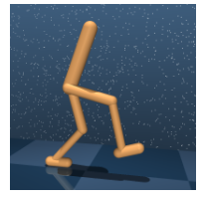
Experiments: The Dataset
In the stand task reward is a combination of terms encouraging an upright torso and some minimal torso height. The walk and run tasks include a component encouraging forward velocity.
Benchmarking Domains. Top: Cheetah, Finger, Fish, Hopper. Bottom: Point-mass, Reacher, Swimmer (6 and 15 links), Walker.
RANDOM
DIAYN
RND
<
<
Random behavior
Maximizes an information theoretic objective using a maximum entropy policy
Maximizes the error of a neural network predicting features of the observations given by a fixed randomly initialized neural network
Tassa et al. (2018) ‘DeepMind control suite’ in arXiv
Burda et al. (2018) ‘Exploration by Random Network Distillation.’ in arXiv
Eysenbach et al. (2018) ‘Diversity is all you need: Learning skills without a reward function.’ in arXiv

Slide 29
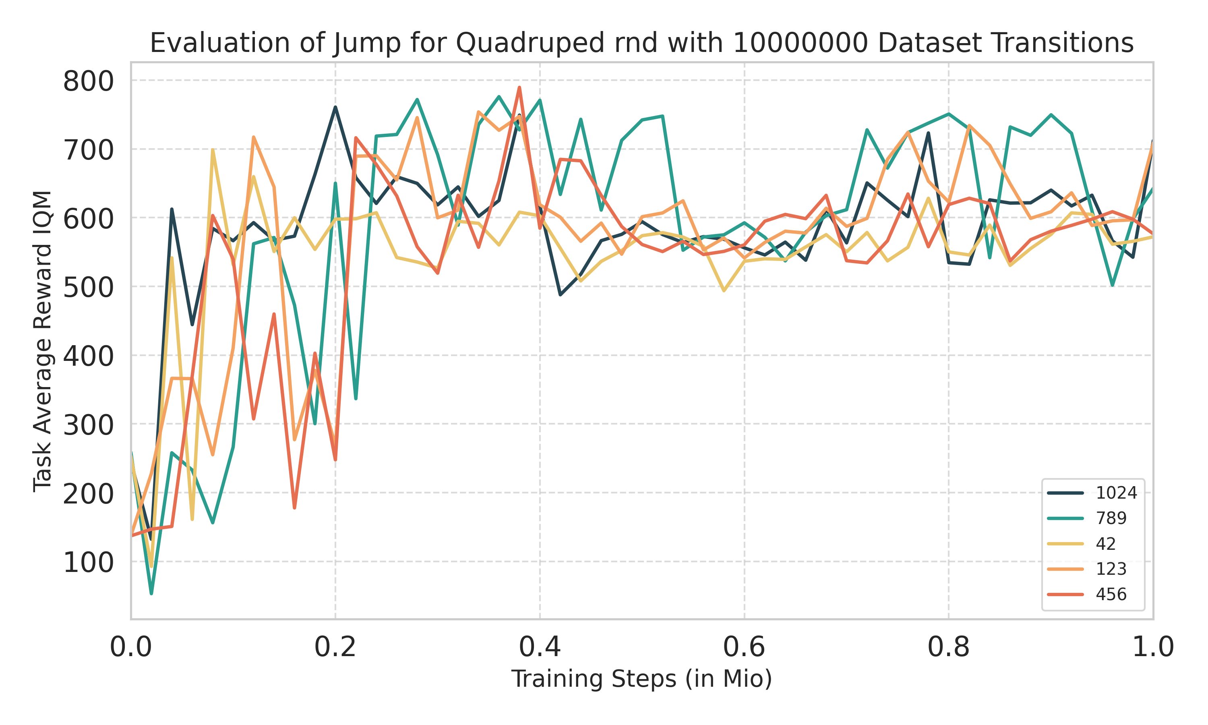
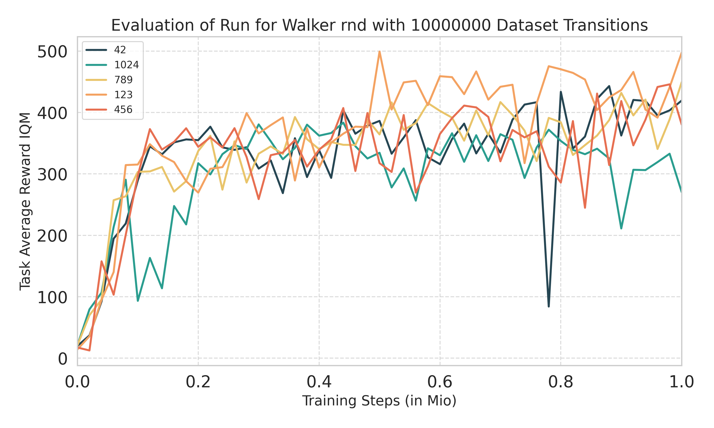
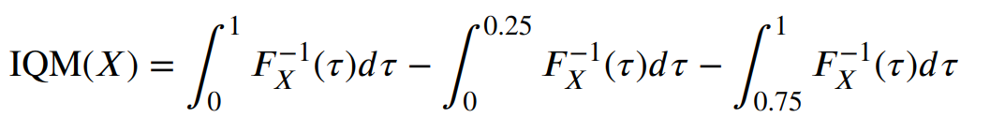
Experiments: Performance Metric
For a random variable 𝑋 with cumulative distribution function 𝐹𝑋 , the IQM is defined as:
+
average over
5 random seeds
Agarwal et al. (2018) ‘Deep RL at the Edge of the Statistical Precipice’ in NeurIPS
Notes:
what location looking at ? How to compaer different curves ? - avoid overfit taking into account
- take the training speed into account ?
- the last point ?
- some average on the 20 last percent ?
NB: experiments: 17 hours to run // 11 hours for a single A800 GPU - > 2 weeks of running for the final results

Slide 30
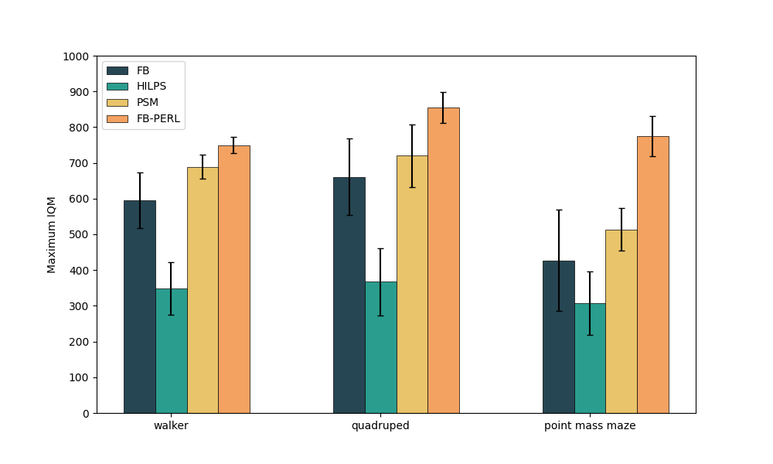
Experiments: RND Walker
Maximum IQM performance achieved by the algorithms, trained on RND dataset in
the walker environment on the three robots walker, quadruped, point mass maze after 1 M steps
Notes:
Algorithm with better performance in reduced computing time !
benefits further optimization/evolution on transformers

Slide 31
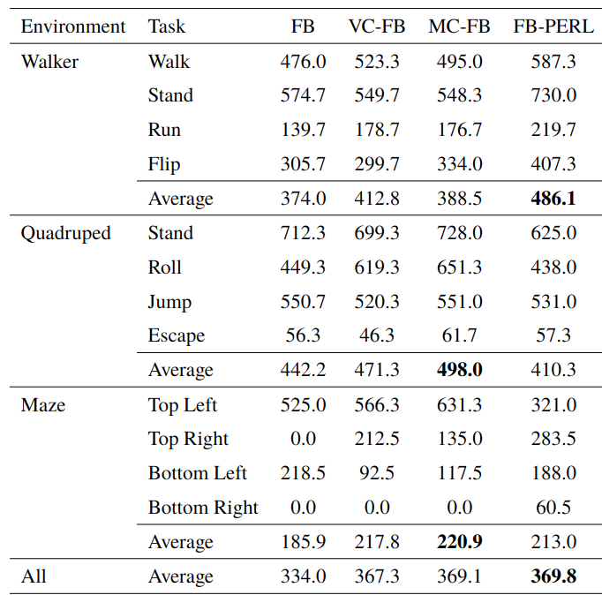
Experiments: Averaged RND/DIAYN/RANDOM
Comparison of FB, VC-FB, MC-FB, and FB-PERL averaged across DIAYN, RND, and RANDOM 1M datasets

Slide 32
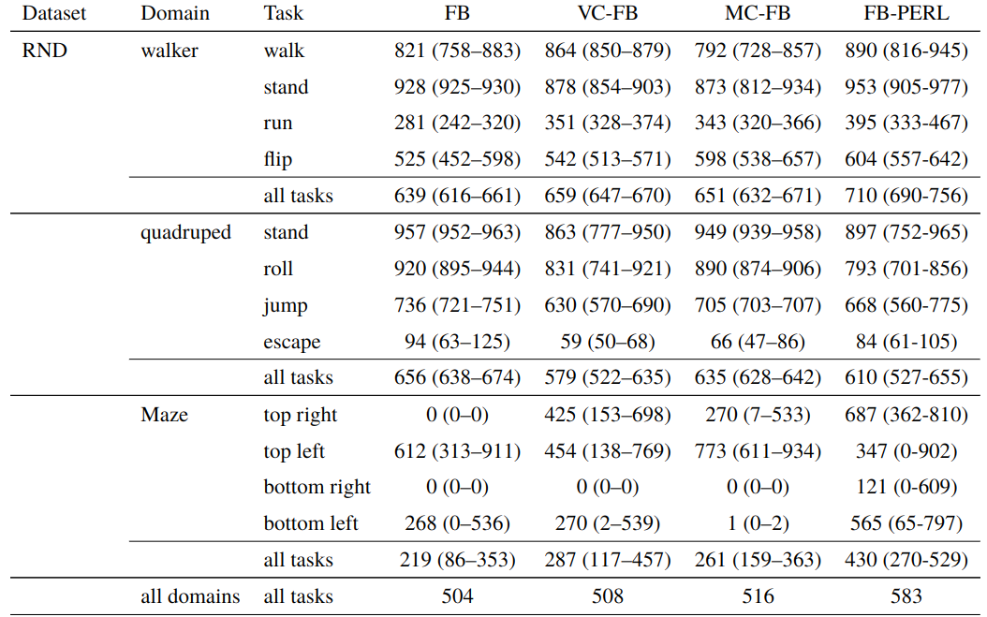
Experiments: RND
Comparison of FB, VC-FB, MC-FB, and FB-PERL averaged on RND 1M datasets
Notes:
Discussion about the result variability: impossible to make a model that fits everything, is better everywhere (small and big datasets, whatever data quantity)

Slide 33
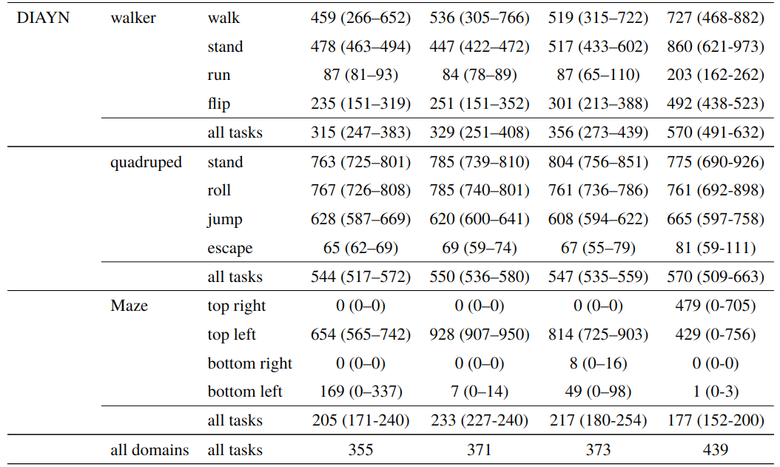
Experiments: DIAYN
Comparison of FB, VC-FB, MC-FB, and FB-PERL averaged on DIAYN 1M datasets
Notes:
Discussion about the result variability: impossible to make a model that fits everything, is better everywhere (small and big datasets, whatever data quantity)

Slide 34
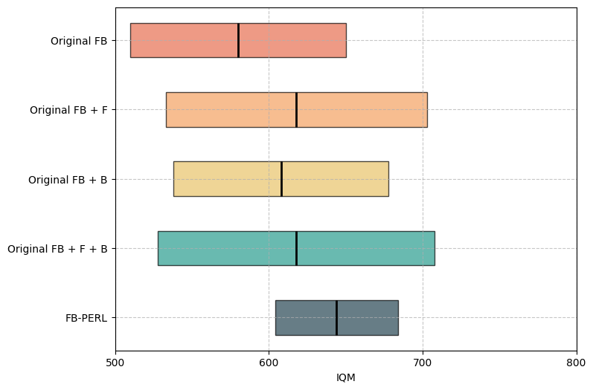
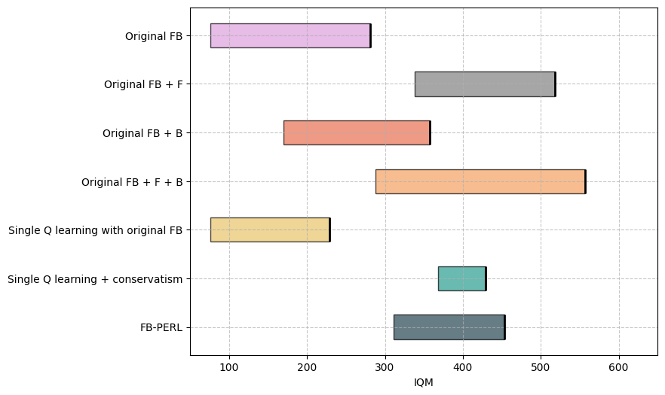
Experiments: Ablations
Ablation studies averaged over walker, quadruped, and point mass maze (1M transitions)
Ablation studies averaged over walker, quadruped, and point mass maze (100k transitions)

Slide 35
Content
Zero-Shot RL Introduction
Related Works
Methodology
Experiments
Conclusion

Slide 36
Conclusion
Enhanced FB Representation Learning Algorithm
OOD Regularization
New NN structure
9% to 34% improvement on walker RND compared to previous SOTA works
Reduced training time
(17 hours to 11 hours)
More flexible architecture

Slide 37

Thanks !
Notes:
Thanks for coming

Slide 38
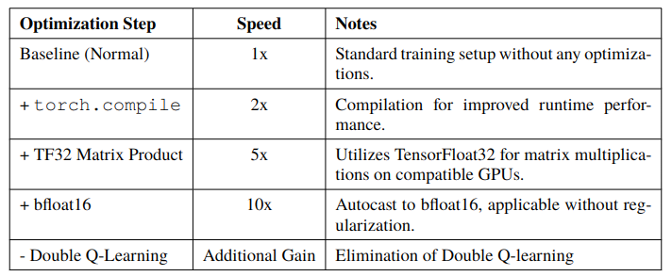
Other work done

Slide 39
Training phase
ACTION
REWARD
STATE

